Slide 1
My prayers go out to the victims of WQ2.

Slide 2

MOOOOAAARRRR Dynamic Programming
Suyash Shekhar

Slide 3
MOOOOAAARRRR Dynamic Programming more like RECURSION
Suyash Shekhar

Slide 4
“modified” TRAVELLING SALESMAN PROBLEM

Slide 5
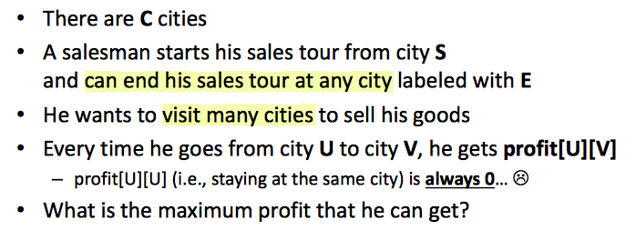

Slide 6
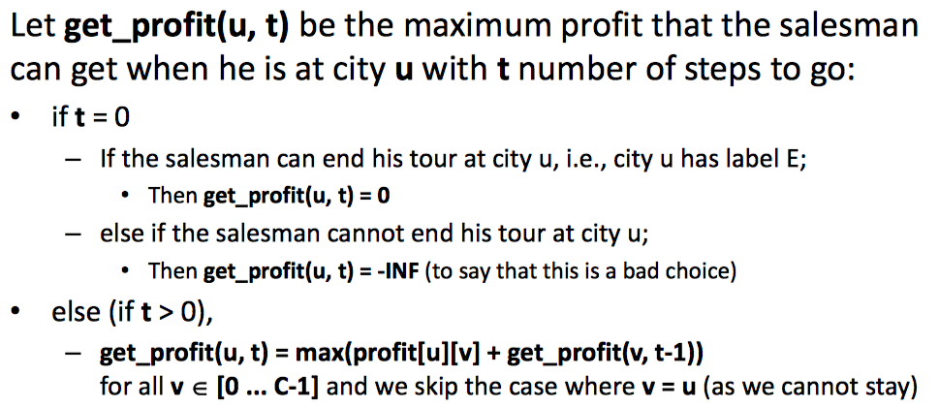

Slide 7
TRAVELLING SALESMAN PROBLEM

Slide 8
Given a set of cities and distance between every pair of cities, the problem is to find the shortest possible route that visits every city exactly once and returns to the starting point.

Slide 9
V! possible tours to visit every node and return to source

Slide 10
Naive Solution: Generate all V! permutations Compare their edge weight sums

Slide 11
GENERATING PERMUTATIONS USING “new modified” DFS

Slide 12
DFS WITH BACKTRACKING!

Slide 13
DFSrec(u) visited[u] ← 1 for all v adjacent to u if visited[v] = 0 p[v] ← u DFSrec(v) for all v in V visited[v] ← 0 p[v] ← -1 DFSrec(s)
DFS

Slide 14
DFSrec(u) visited[u] ← 1 for all v adjacent to u if visited[v] = 0 p[v] ← u DFSrec(v) visited[u] ← 0 for all v in V visited[v] ← 0 p[v] ← -1 DFSrec(s)
backtracking
DFS

Slide 15
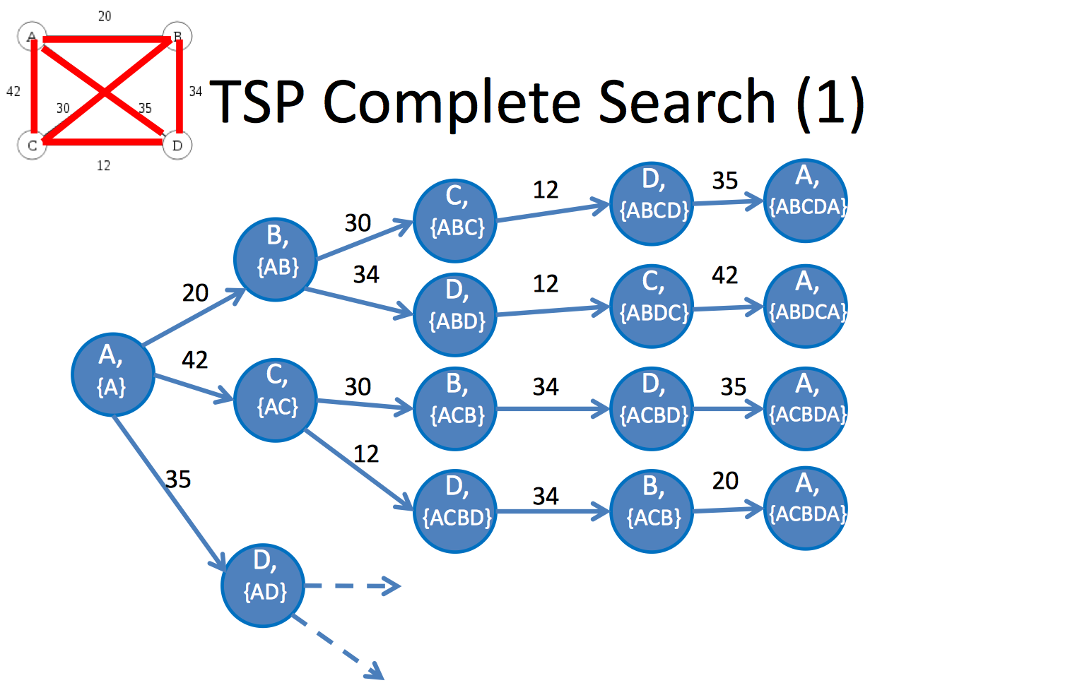

Slide 17
Longest Common Subsequence

Slide 18
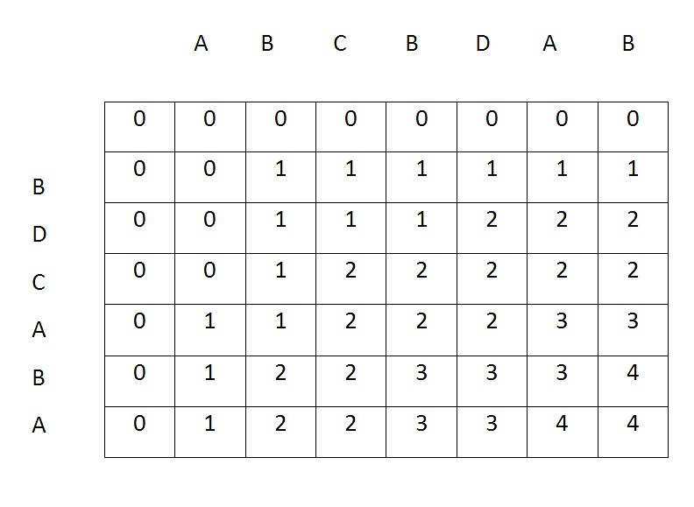

Slide 19
if A[i] == B[j]: return LCS(i-1, j-1) + 1 else: return max(LCS(i-1, j), LCS(i, j-1))

Slide 20
on to the tutorial

Slide 21
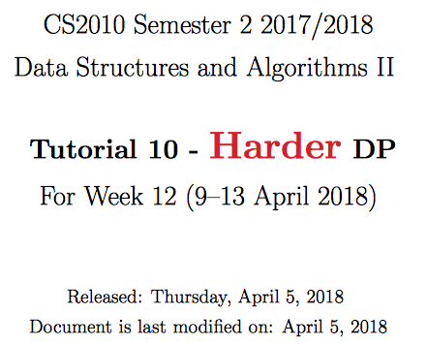
its actually just memoised recursion and graphs today

Slide 22
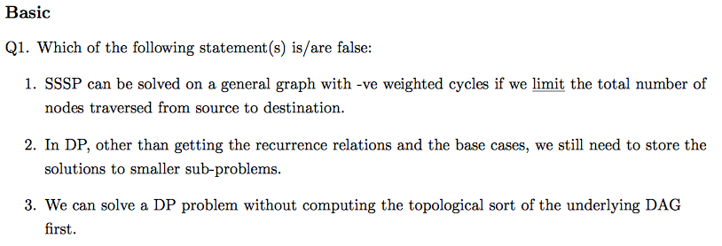

Slide 23
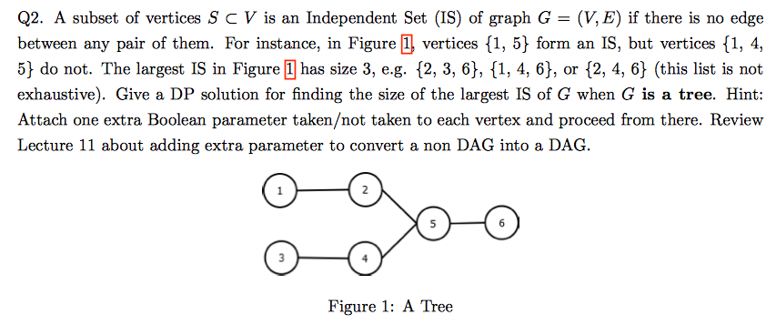

Slide 25
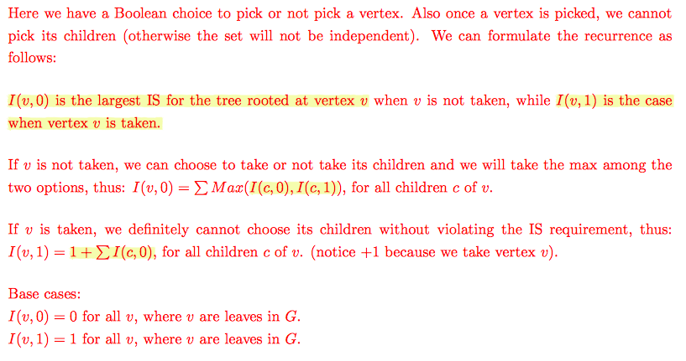

Slide 26

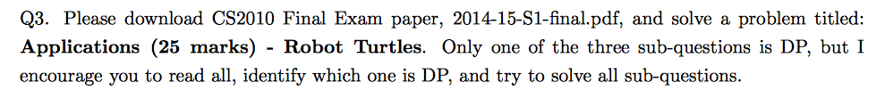

Slide 27
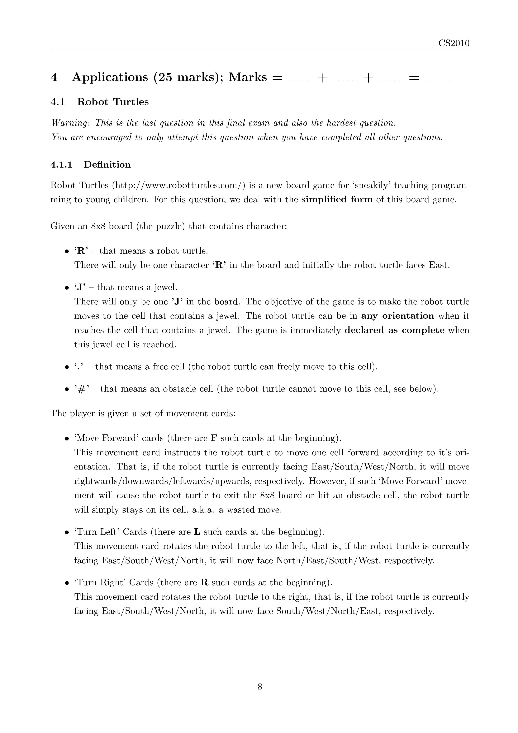
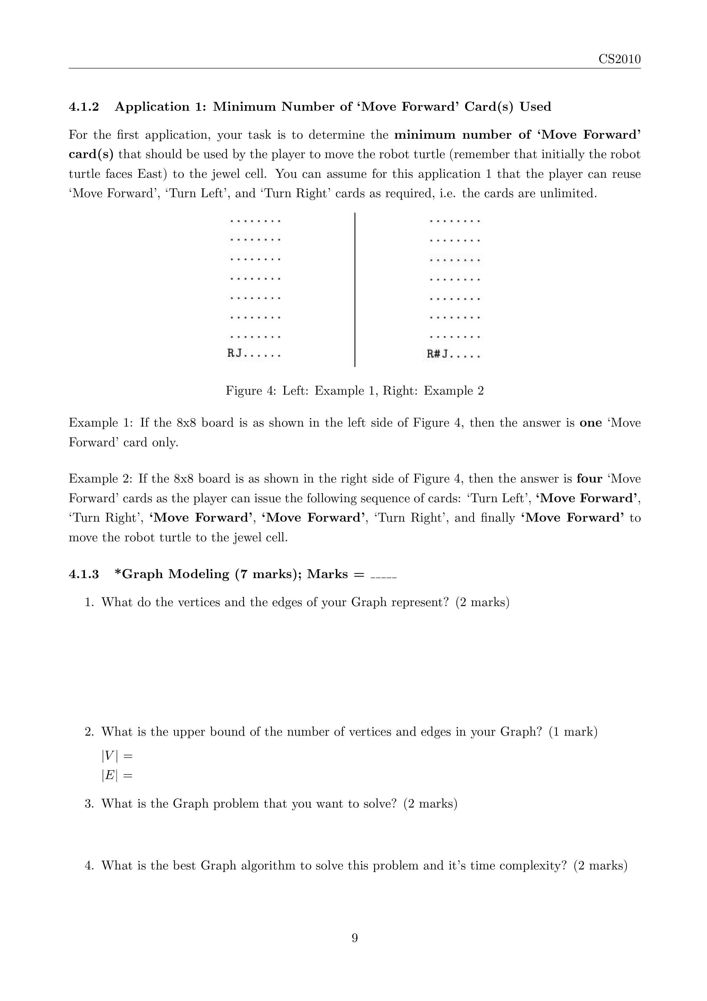

Slide 28
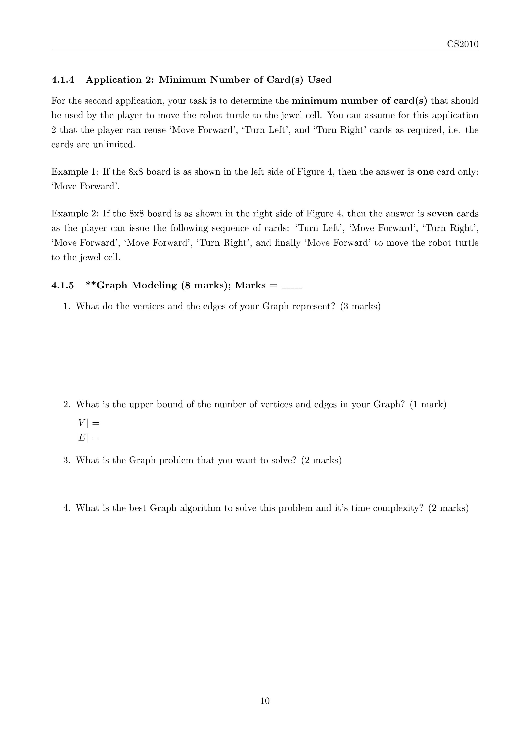
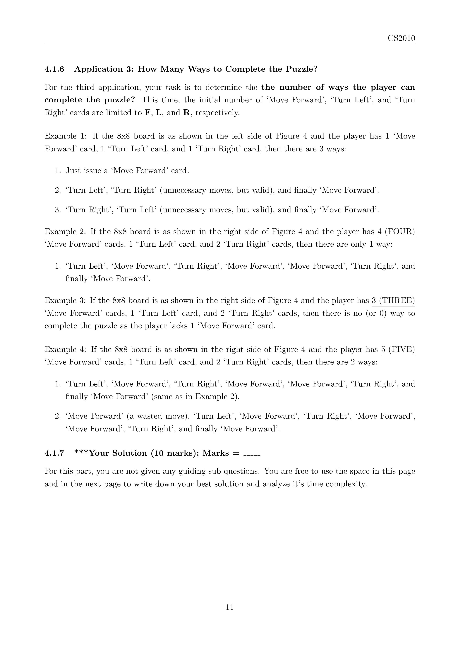

Slide 29
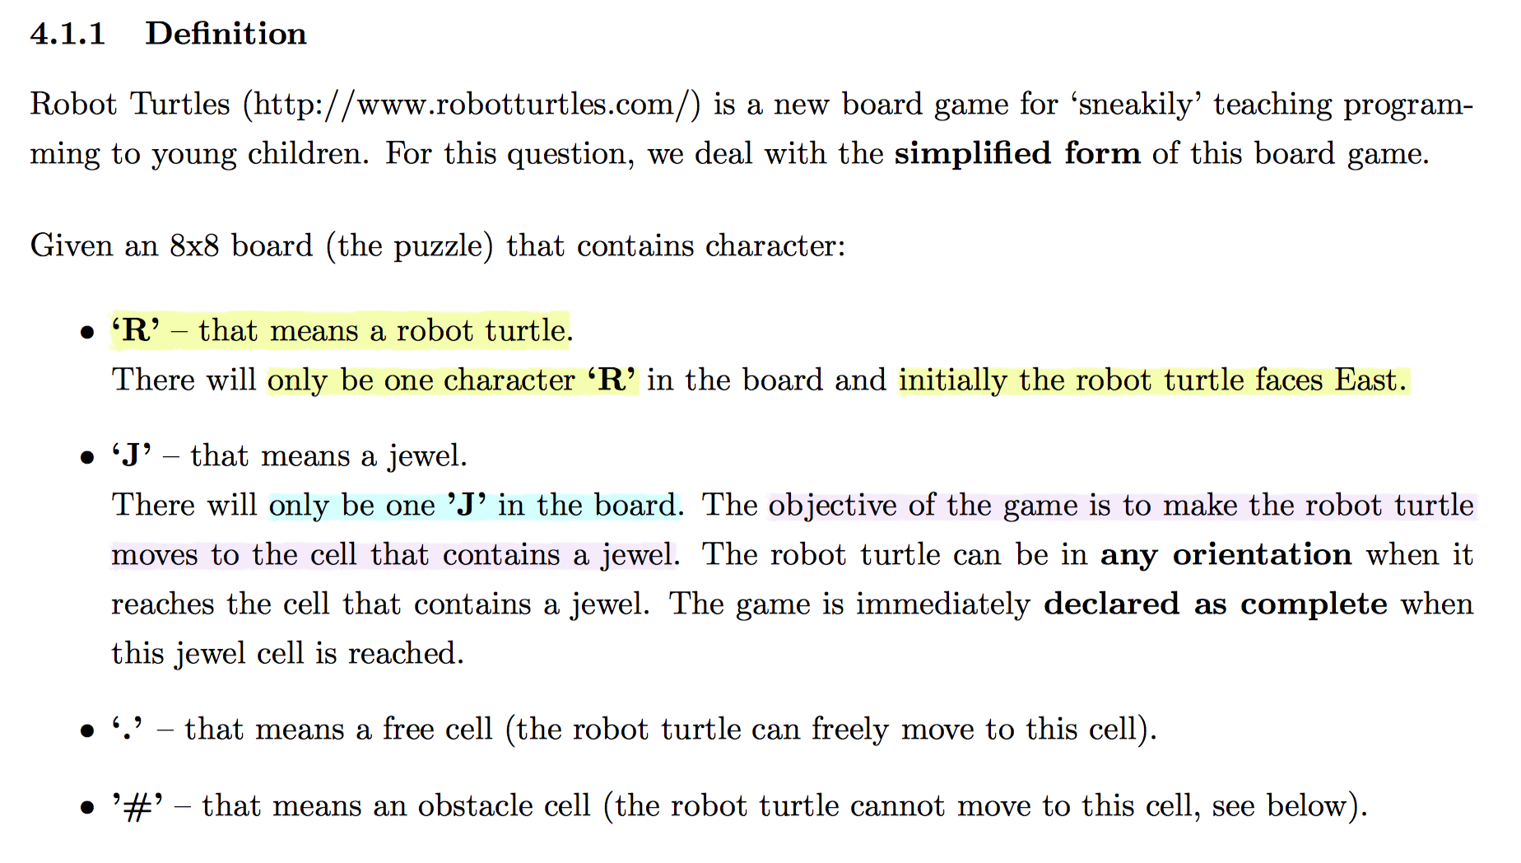

Slide 30
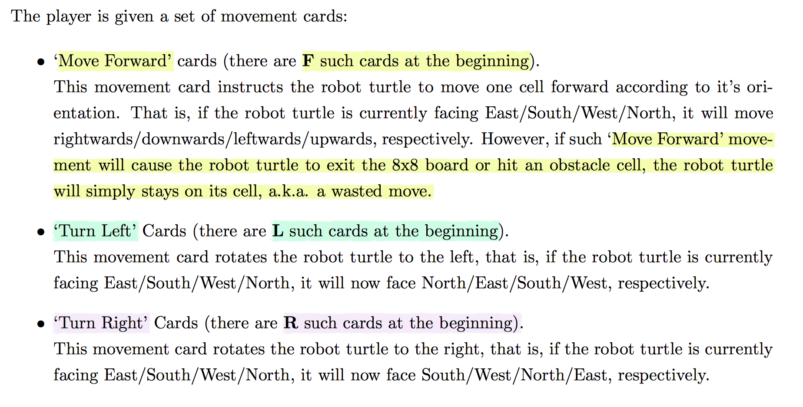

Slide 31
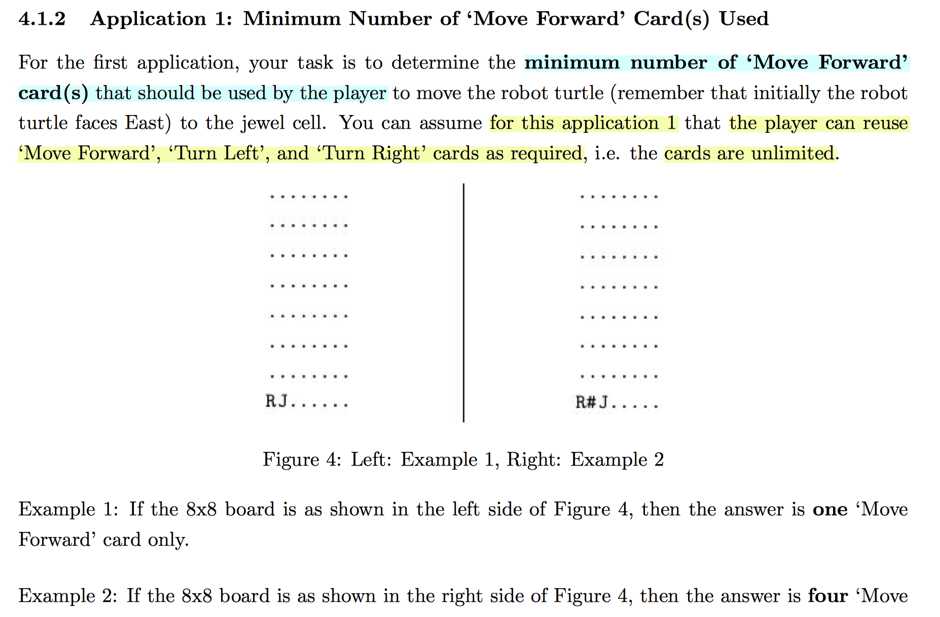

Slide 32
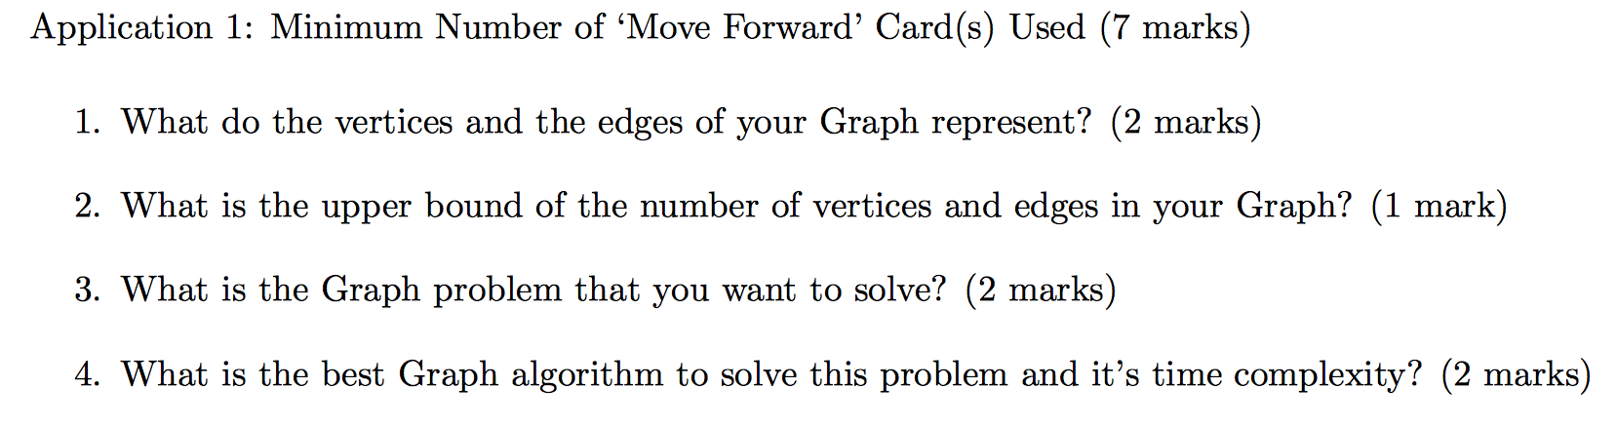

Slide 33
state space

Slide 34
state space?

Slide 35
....J
.##..
.#..#
.R.##
←

Slide 36
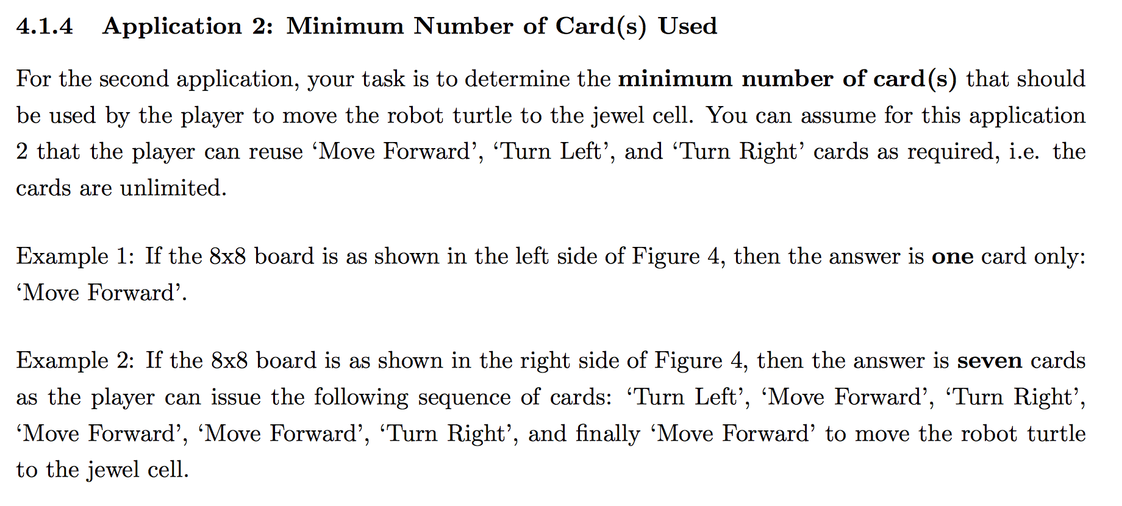

Slide 37
state space

Slide 38
state space.

Slide 39
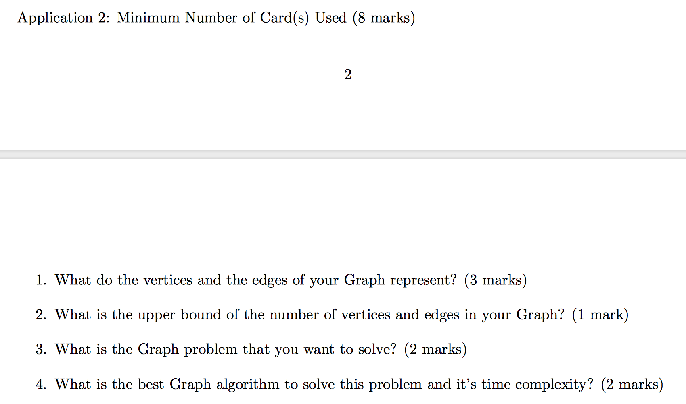

Slide 41
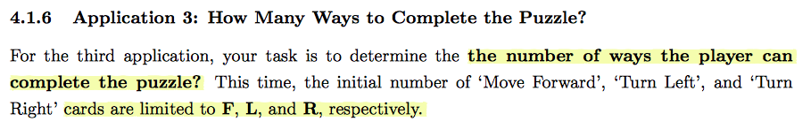

Slide 42
Add more into to state Memoise solutions

Slide 44
BYE

